Slide 1
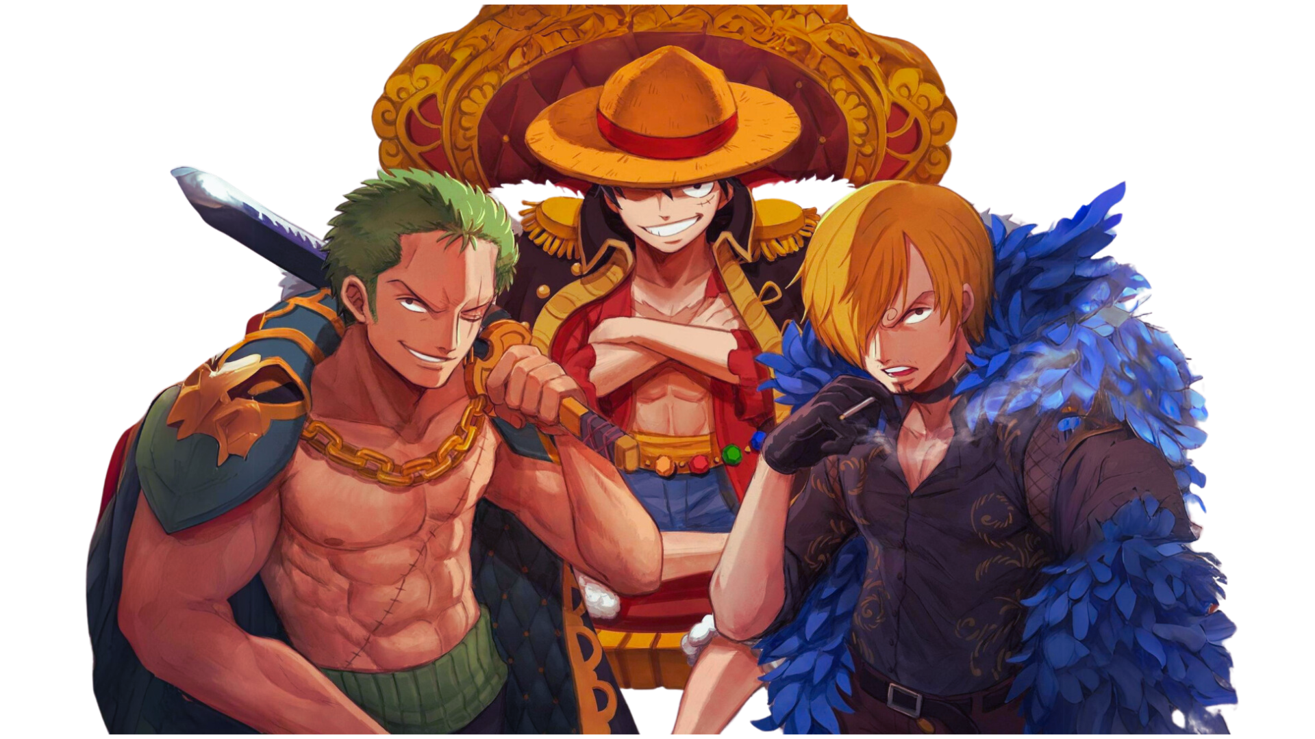

CODE BANDIT

Slide 2

Image Classification: Animal Classifier
Predicting Dog, Cow, Cat, Lamb, and Zebra Classes

Slide 3
Done By:
Kazi Minhaz Uddin Sami
2031733642
Md. Mehdi Hassan
1921539042
Ittihad Ahmed Anindya
2031372642
Submitted To:
Mohammad Shifat-E-Rabbi
Assistant Professor North South University

Slide 4
Introduction
01

Slide 5
Objective
Develop an image classification model to distinguish between five animal classes (dog, cow, cat, lamb, zebra) with 90% accuracy.
Key Tasks
Data collection and preprocessing
Model training and evaluation
Ensure reproducibility and save the trained model

Slide 6
Dataset Collection
02

Slide 7
01
02
Classes
Images per Class
Dog, Cow, Cat, Lamb, Zebra
100 (Total: 500 images)
03
04
Library Used
Process
Google Image Crawler
Download images using multi-threaded crawling
Save images in class-specific folders

Slide 8
Data Preprocessing
03

Slide 9
Steps
Load images from directory using load_img and img_to_array
Resize images to 128x128 pixels
Flatten 2D images into 1D arrays
Check and balance class distribution

Slide 10
Model Architecture
04

Slide 11
Why Random Forest?
Easy implementation and low computational cost
Robust performance with tabular data and numerical features

Slide 12
Model Training
05

Slide 13
Training Process
Split data into training (80%) and validation (20%) sets using train_test_split
Train Random Forest Classifier on processed data

Slide 14
Evaluation
06

Slide 15
Characteristics of vertebrates
Validation Accuracy
Performance Metrics
Challenges
Achieved 88.68%
Accuracy Score: Calculated using accuracy_score
Potential overfitting or underfitting due to dataset size

Slide 16
Saving and Deployment
07

Slide 17
01
02
Saved Model
Future Use
Used joblib to store trained model as animal_classifier_rf_model.pkl
Model can be reloaded and reused for predictions on new datasets

Slide 18
Limitations
08

Slide 19
01
02
Dataset Size
Model Choice
Limited to 500 images; accuracy could improve with larger datasets
Random Forest is not ideal for complex image data compared to CNNs
03
Image Quality
Variability in resolution and lighting may impact accuracy

Slide 20
Conclusion
09

Slide 21
Summary
Future Work
Successfully developed a Random Forest-based animal classifier
Experiment with Convolutional Neural Networks (CNNs) for improved performance
Expand the dataset with more images and augmentations
Achieved a validation accuracy of over 80%

Slide 22
Thanks!
Do you have any questions?

